Slide 1
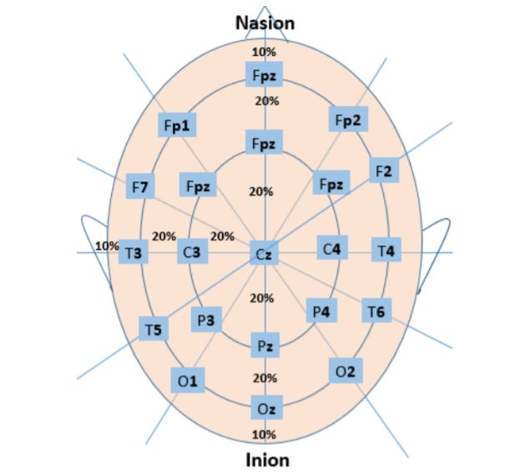
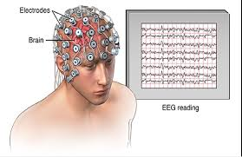
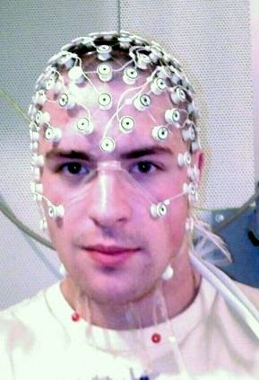
Electroencephalogram (EEG) Signal Analysis
Presented by:
Priyanka Aggarwal – B00123045
Vimal Jaswal - B00122875
Masters of Engineering in Internet of things technologies
TU Dublin, Blanchardstown, Ireland.

Slide 2
Introduction
Electroencephalography (EEG) is a monitoring method to record electrical activity of the brain by placing electrodes on scalp.
First EEG recording was obtained by German physiologist and psychiatrist Hans Berger in 1924.
EEG technology helps in diagnosing brain disorders such as tumors, seizures, Alzheimer’s disease, epilepsy and other disorders.
Brain signals recorded in the EEG are generally categorized as delta, theta, alpha, beta and gamma based on signal frequencies ranges from 0.1 Hz to more than 100 Hz.

Slide 3
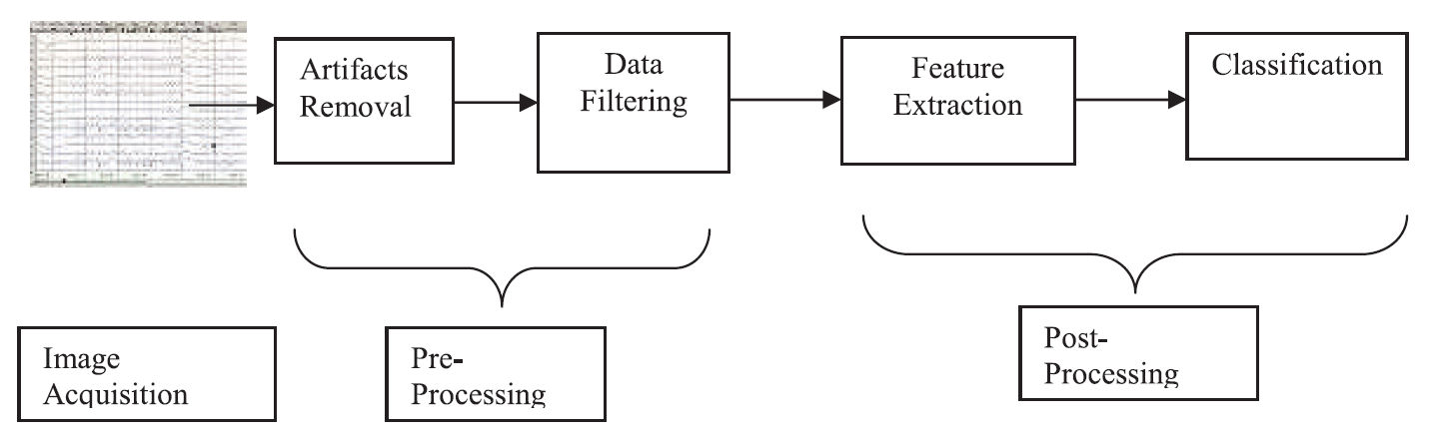
EEG Signal Analysis & its Phases

Slide 4
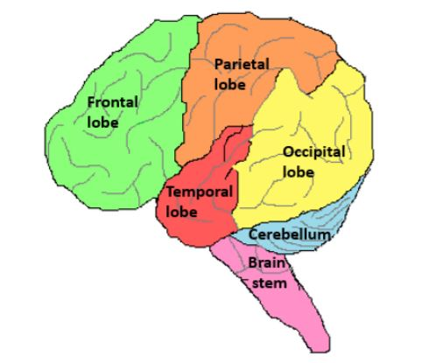
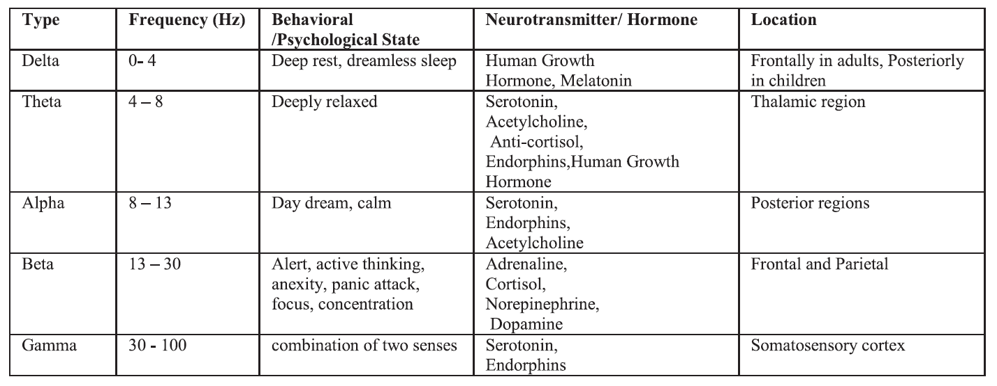
EEG Signals & its Characterizations

Slide 5
Analysing EEG Signal features in Time & Frequency domain
Fourier Transform spectrum
Power Spectrum
Correlation with behaviour
Spectrogram
Wavelets Analysis

Slide 6
EEG Signal Usage in IoT Applications
Integration of Brain-Computer Interfaces and Internet of Things

Slide 7
EEG Signal Noise Sources
Artifacts: The recorded activity which is not of cerebral origin.
Physiologic: Patient related artifacts
Artifacts from the eyes and eyelids. (3Hz –10Hz)
Eye movement artefacts.
Eye blink
Muscle artefacts (15-30Hz)
Cardiac Artefact
Extra physiologic or External artifacts:
Technical artifacts (50/60 Hz artifact, cable movements, electrodes)
External, environmental sources of noise, AC power lines, lighting and array of electronic equipment (from computers, displays and TVs to wireless routers, mobile phones).

Slide 8
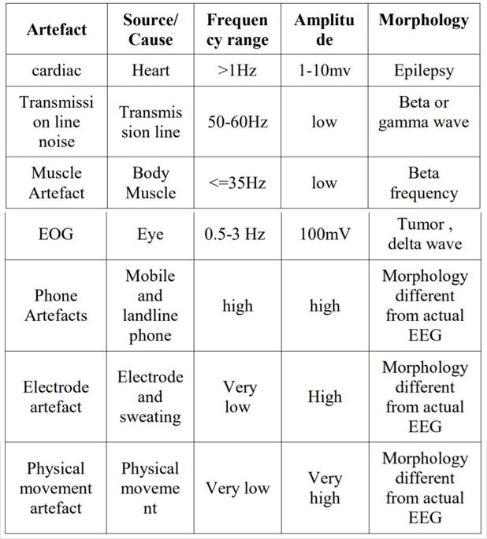
EEG Signal Noise Characteristics

Slide 9
EEG Signal Noise Handling and Filtering
The standard filtering/Bandwidth settings for EEG:
Low frequency filter: 1 Hz High frequency filter: 50-70 Hz
Differential Amplifier: Reduces the effect of common noise that can be present on the input electrodes. It magnifies the difference between two inputs. An unwanted signal that is common to the two inputs is subtracted.
A notch filter is used to reject the 60 Hz or 50 Hz power line noise.
Band-pass or low-pass filters are the commonly used temporal filters which filter out a very high or low frequency bands leaving behind the particular frequency band in which we are interested.
Filtering is commonly done by using Discrete Fourier Transform (DFT) or Finite Impulse Response (FIR) or Infinite Impulse Response (IIR) filters.

Slide 10
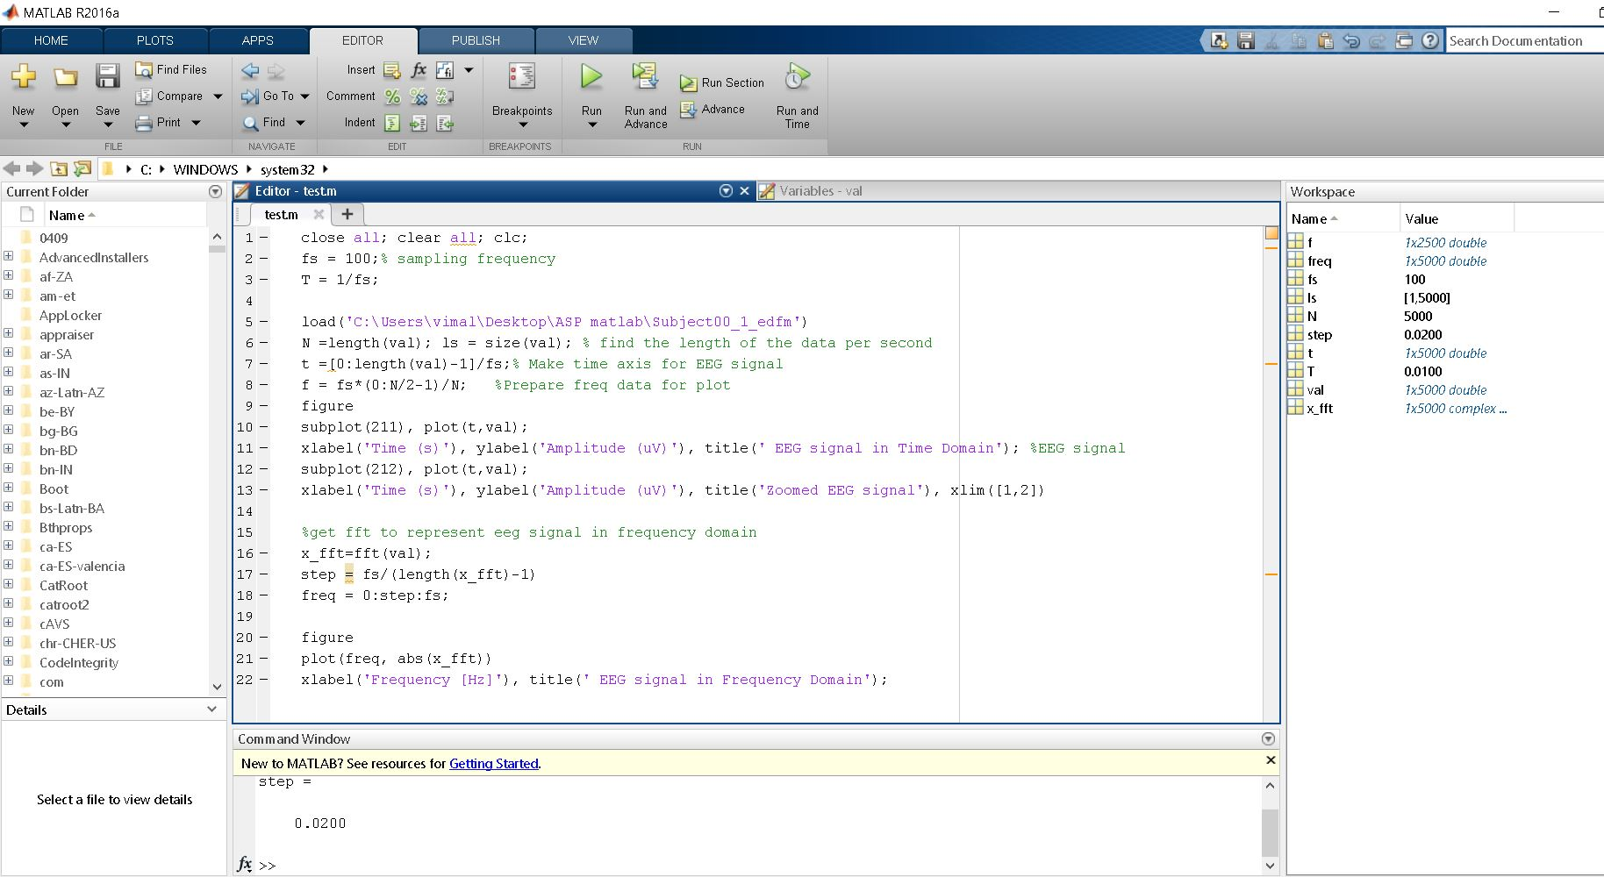
EEG Signal Analysis using MATLAB

Slide 11
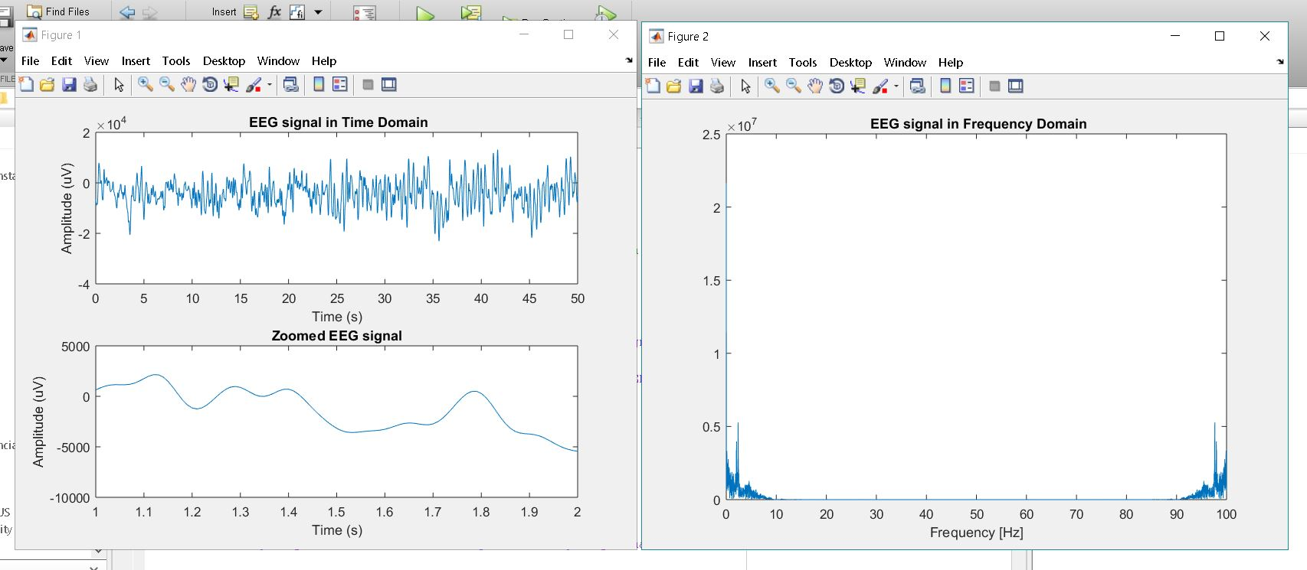
EEG Signal in Time & Frequency Domain

Slide 12
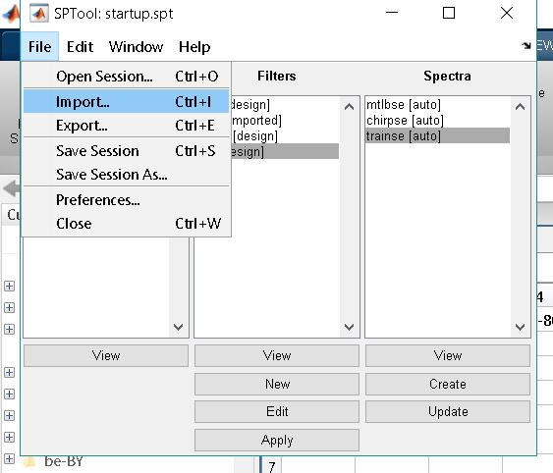
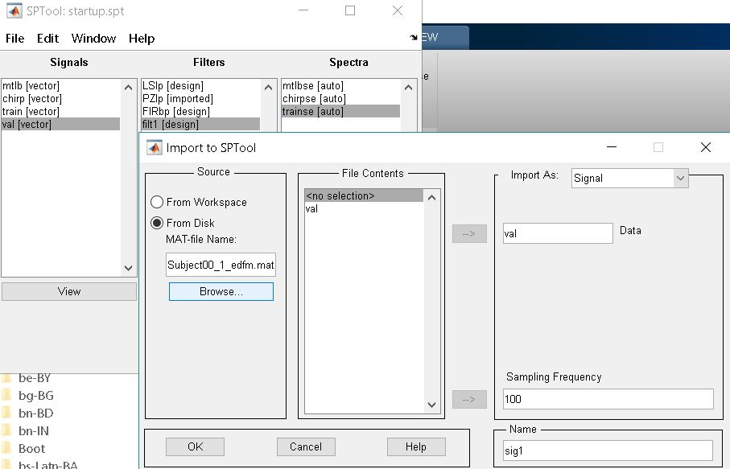
Filter Designer EEG Analysis

Slide 13
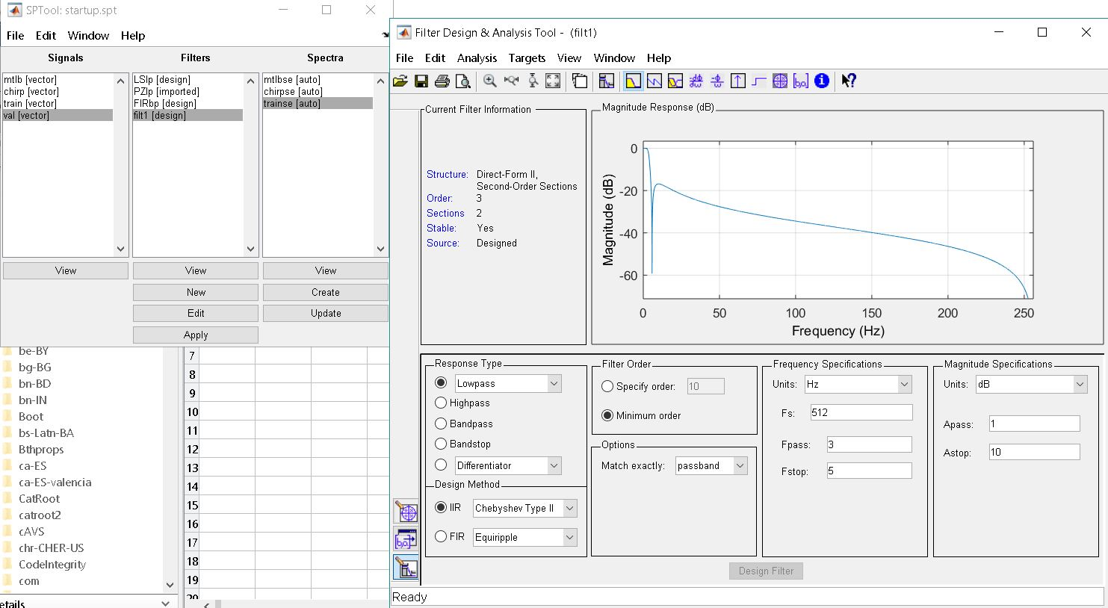
Filter Designer EEG Analysis

Slide 14
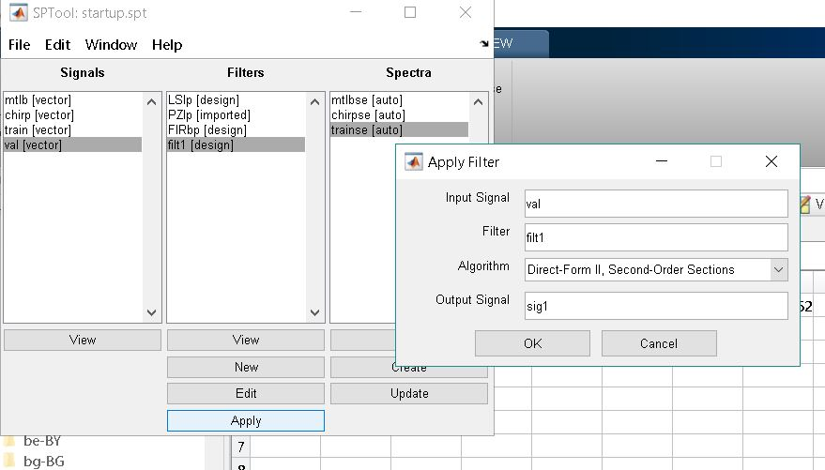
Filter Designer EEG Analysis

Slide 15
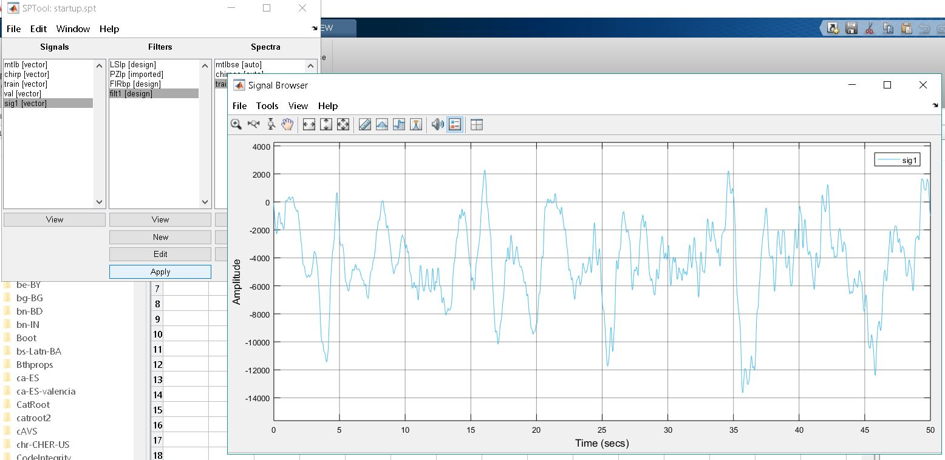
Filter Designer EEG Analysis

Slide 16
References:
[1]J. Kumar and P. Bhuvaneswari, "Analysis of Electroencephalography (EEG) Signals and Its Categorization–A Study", Procedia Engineering, vol. 38, pp. 2525-2536, 2012. Available: 10.1016/j.proeng.2012.06.298.
[2]A. Tandle, N. Jog, P. D'cunha and M. Chheta, "Classification of Artefacts in EEG Signal Recordings and EOG Artefact Removal using EOG Subtraction", Communications on Applied Electronics, vol. 4, no. 1, pp. 12-19, 2016. Available: 10.5120/cae2016651997.
[3]S. Munian, S. Sivalingam and V. Jayaraman, "Analysis of Real Time EEG Signals", Masters, Linnaeus University, 2014.
https://physionet.org/physiobank/database/eegmat/
EEG During Mental Arithmetic Tasks (Subject00_1_edfm) EEG-Fp1

Slide 17
Thank You

